Slide 1






Hello Everyone!
Group 9
Object Oriented Programming
(C# Language)
MSIS2433.M12.CTTT
Lecturer: Nguyễn Thanh Bình
TA: Đinh Hoàng Nhi
NGUYỄN HUỲNH THẢO NHƯ
19521970
TRẦN THỊ CẨM TÚ
19522458
SALES MANAGEMENT SYSTEM

Slide 2

WHY?
Choose this topic
I.Introduction of the project:
1. Problem definition:
2. Scope of the project:
3. Objectives, necessity of the topic:

Slide 3

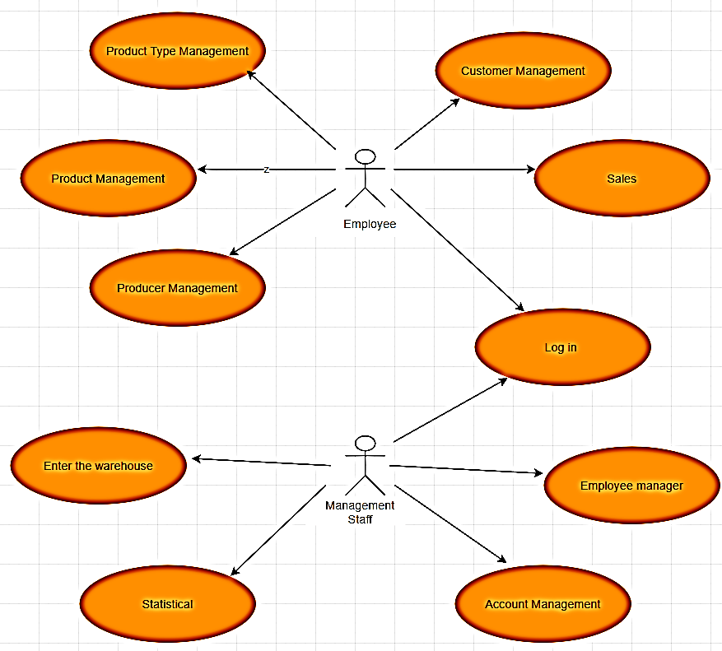

II. Topic analysis:
System Use –Case Diagram
The main functions of sales management software include:
- Product Type Management
- Product Management
- Producer Management
- Employee manager
- Account Management
- Customer management
- Import
- Statistical
- Sell

Slide 4

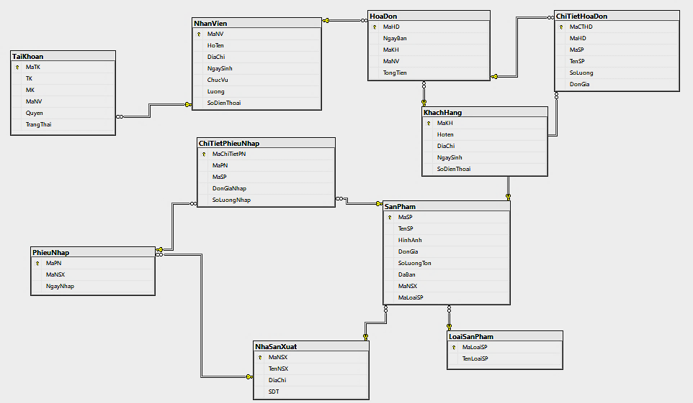

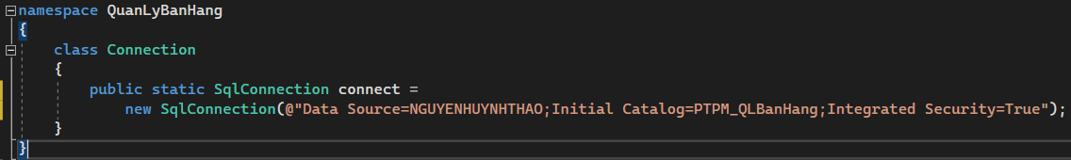
Database

Slide 5

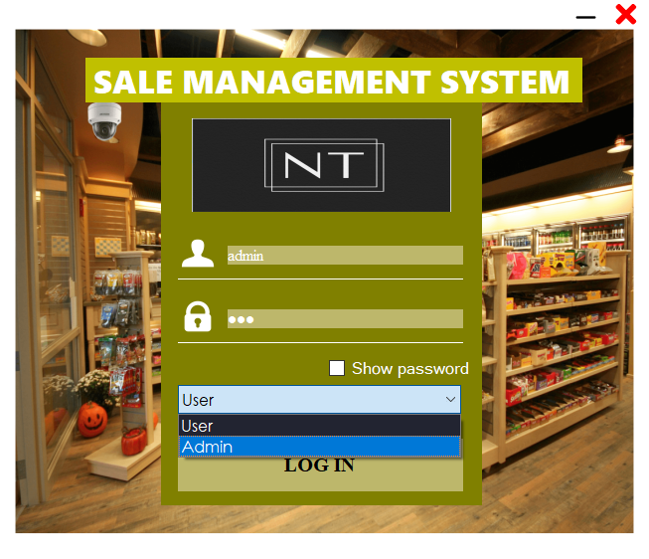
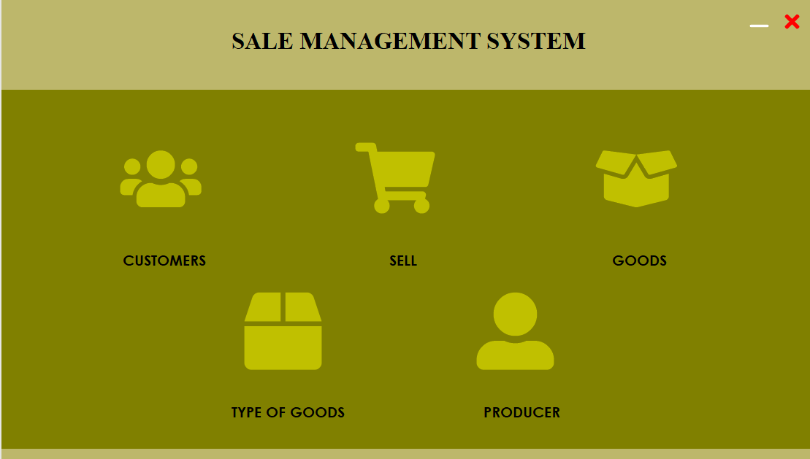
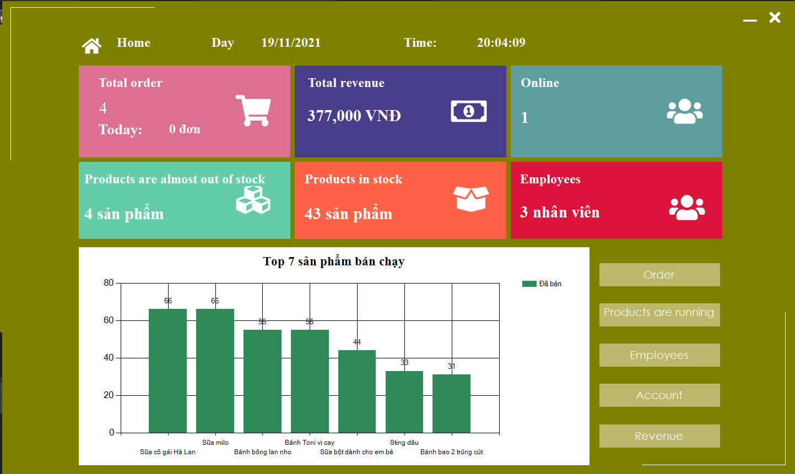
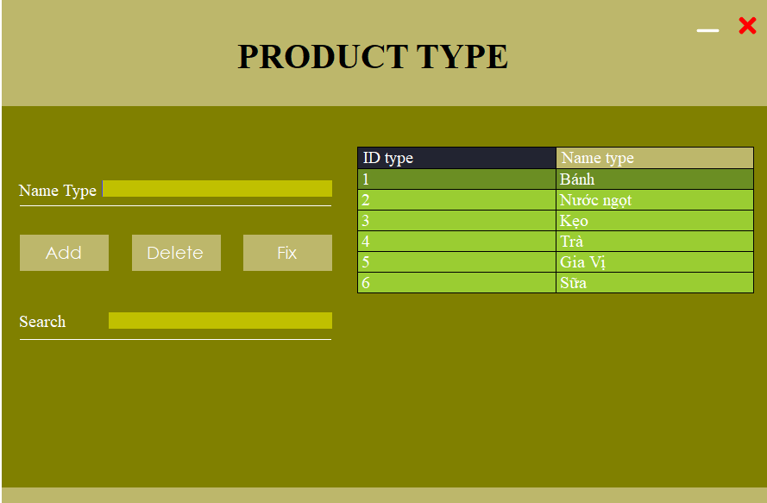
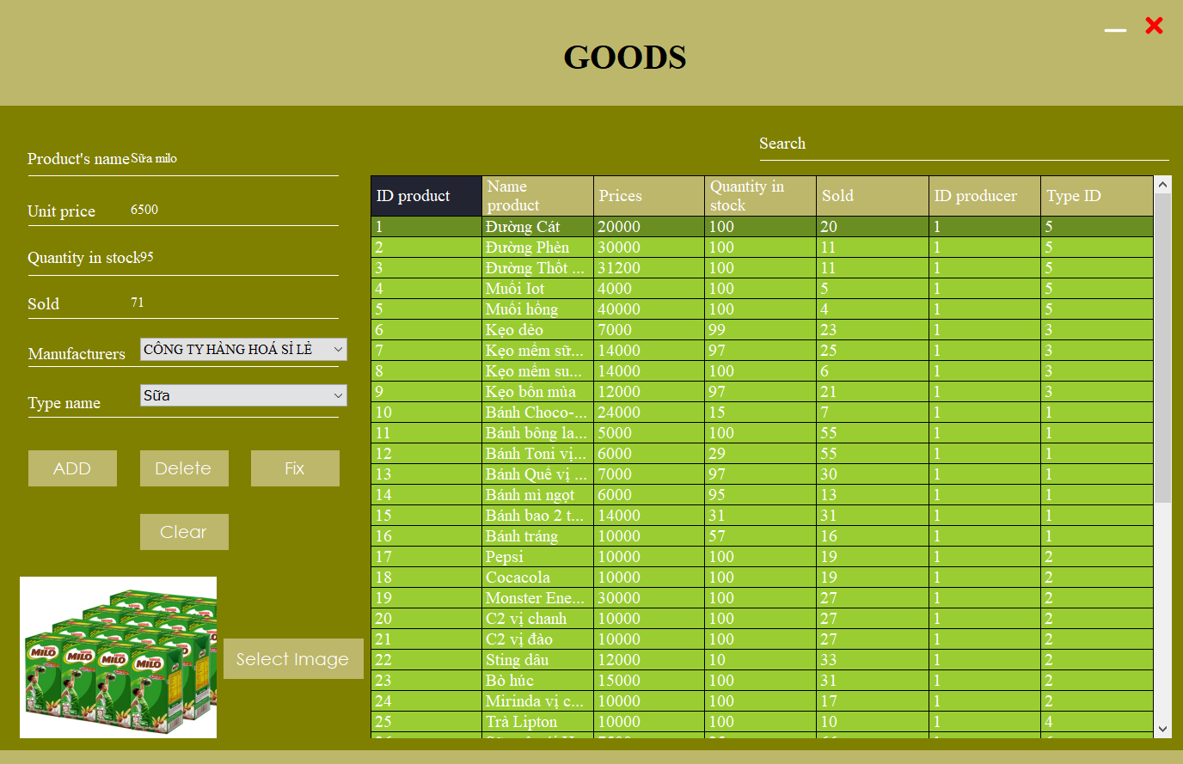
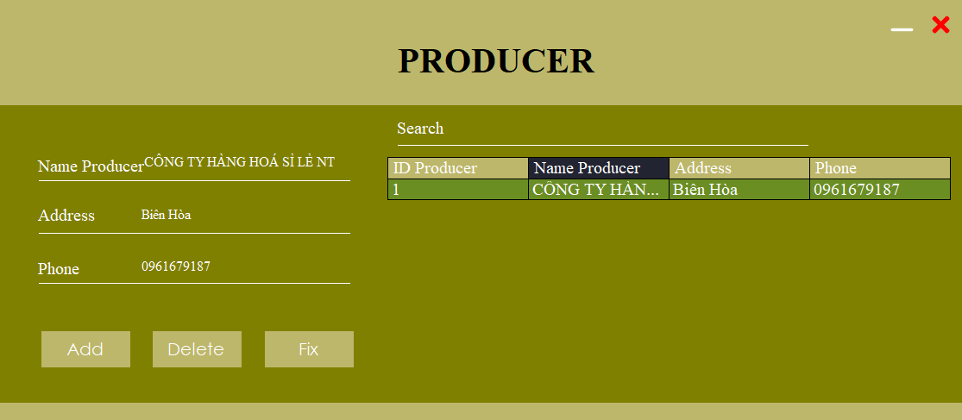

III. Demo Form

Slide 6

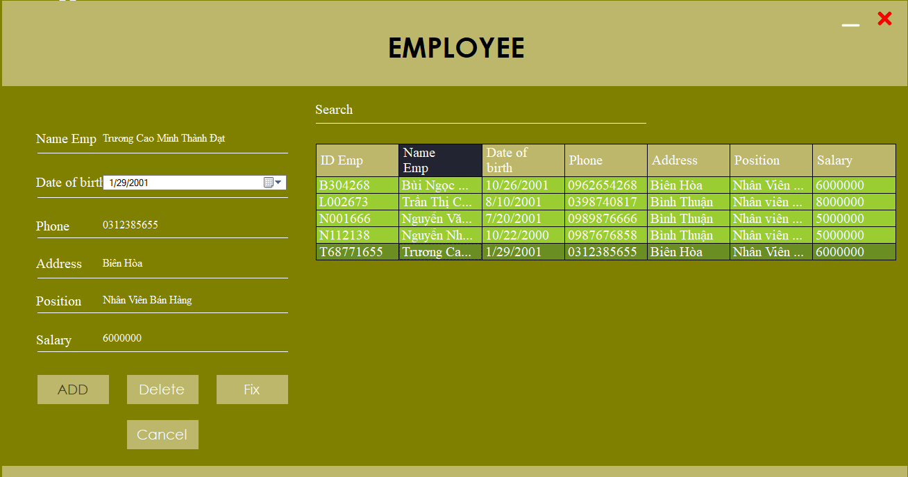
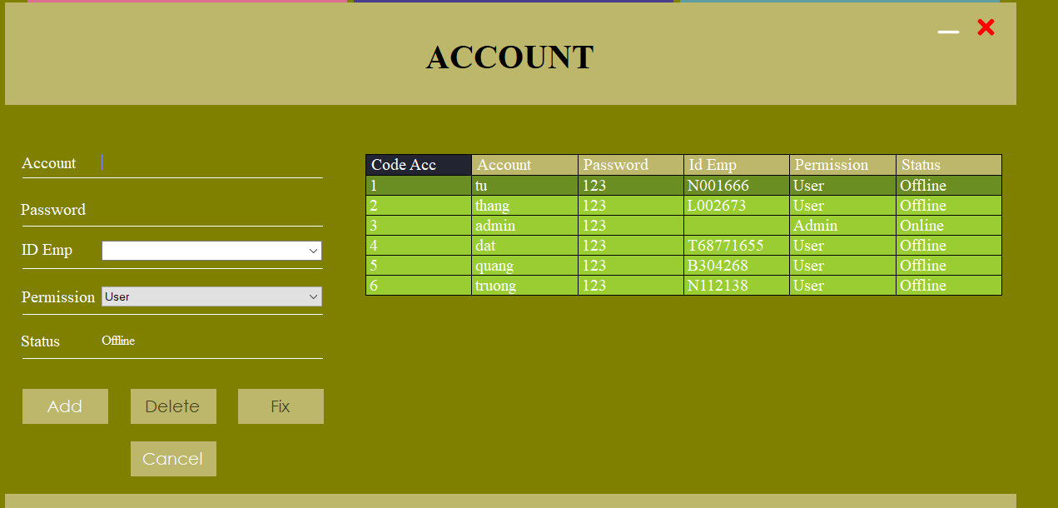
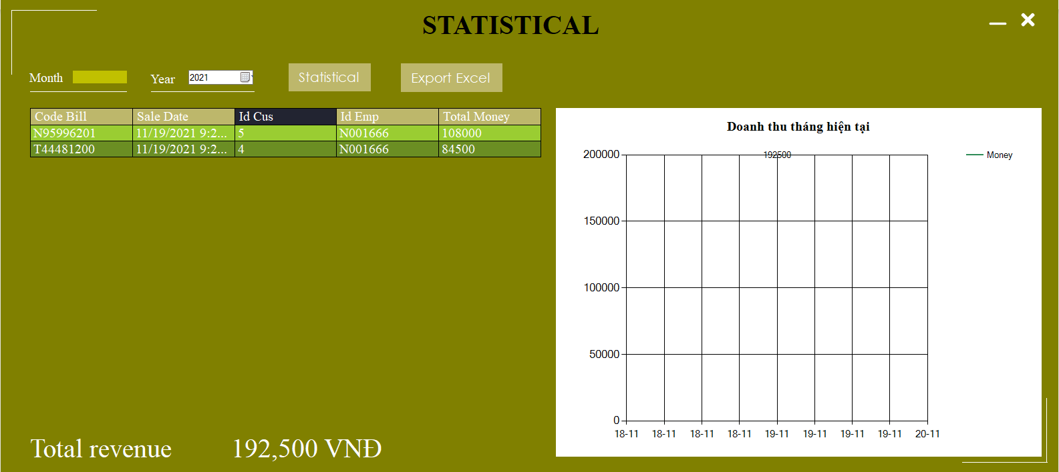
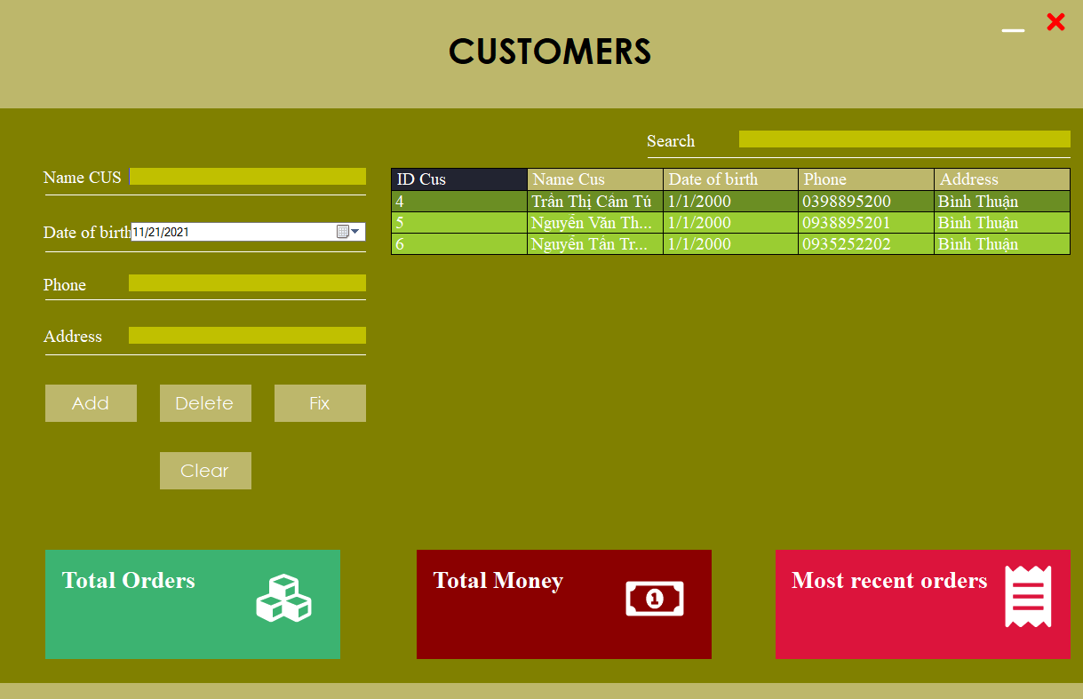
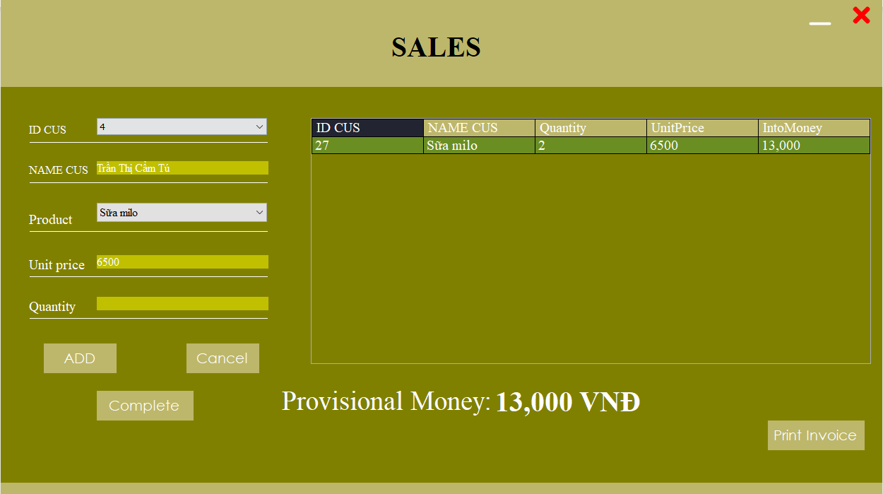
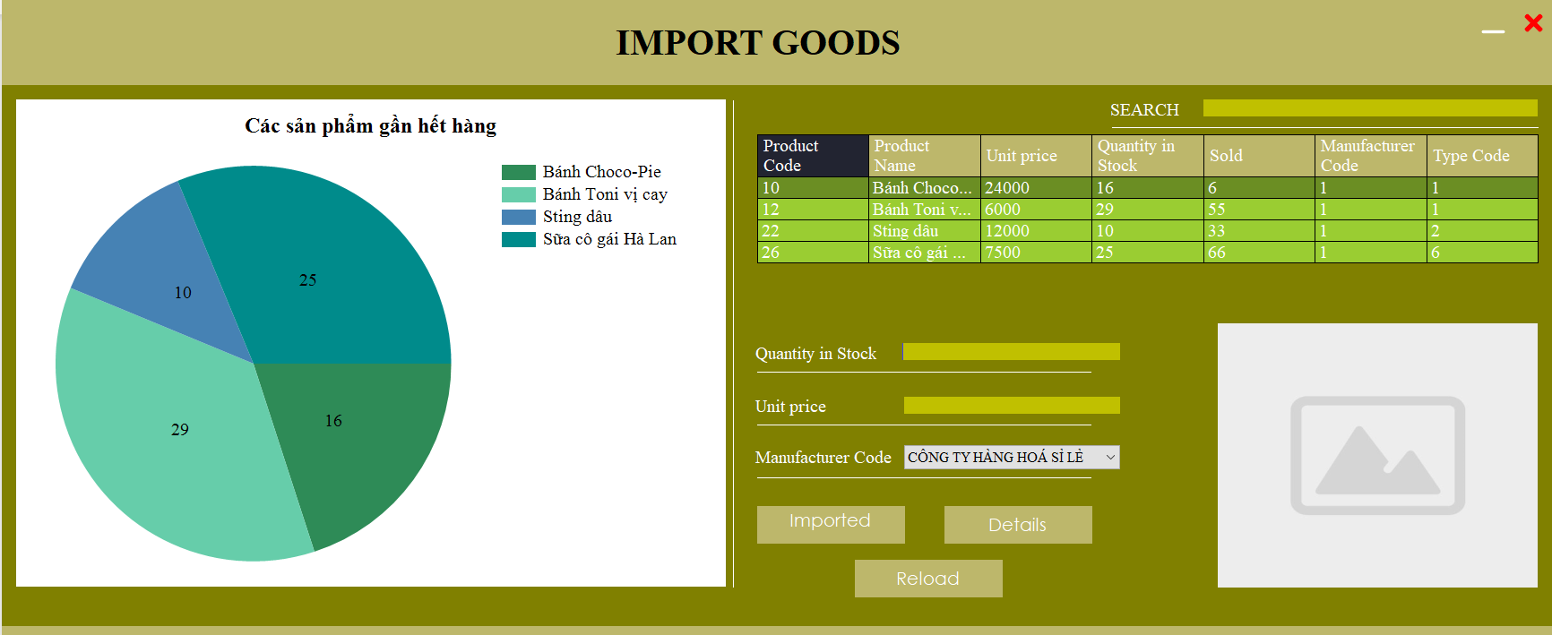

III. Demo Form

Slide 7


V. Tài liệu tham khảo: (chính sharecode.vn)
Giáo trình Phân tích thiết kế hệ thống thông tin - Trường Đại học công nghiệp thực phẩm.
Giáo trình công nghệ phần mềm - Trường Đại học công nghiệp thực phẩm.
Giáo trình phát triển phần mềm - Ứng dụng thông minh.
Stack Overlow fix bugs: https://stackoverflow.com/
Chart Control in Windows Forms Application: https://www.c-sharpcorner.com/UploadFile/1e050f/chart-control-in-windows-form-application/?fbclid=IwAR3JQTIm-yOBLBnfiDfFCz0xMEZeSCLIINOBClk36phK26JmwIOJ-Cst5Bo
Print Receipt using Report Viewer: https://www.youtube.com/watch?v=JoiLvAmksco&t=970s
Image Upload picturebox and save into folder windows forms C#: https://www.youtube.com/watch?v=TqWP1rpkx9k
How to load image into picturebox control | 4 different ways: https://www.youtube.com/watch?v=9ZM2brRSnVs

Slide 8

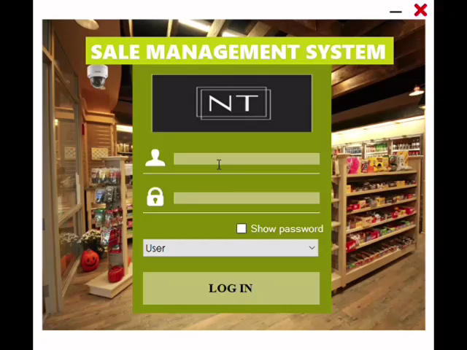

DEMO

